Slide 1

SAFRAN engineering services programming under DO178 - 332

Slide 2
DO-178 Overview

Slide 3
DO-178 Overview
DO-178 - Software Considerations in Airborne Systems and Equipment Certification
Standard of RTCA Incorporation (in Europe it is ED-12B and standard of EUROCAE)
Represents the avionics industry consensus to ensure software safety
Acceptable by FAA and EASA certification authorities
"The FAA and the civil aviation community recognize RTCA’S DO-178B as an acceptable means of compliance to the FAA regulations for SW aspects of certification."

Slide 4
Software Levels in DO-178
Different failure conditions require different software conditions -> 5 levels

Slide 5
Examples DO-178 Safety Levels
Safety-critical Levels C&D
Anti-missile defense
Data mining
Health monitoring
Mission planning and implementation
Mission simulation and training
Network-centric operation
Real-time data recording and analysis
Self-healing communication networks
Telemetry
Weapons targeting
Safety-critical Levels A&B
Fly-by-wire controls
Auto-pilot
Air-traffic Separation Control
Glass Cockpit Information Display
Radar
Jet Engine Control
IFF (friend or foe)
Missile guidance
Missile launch
Missile self-destruct

Slide 6
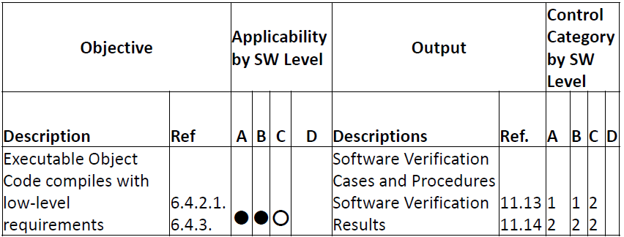
Objectives for Safety Levels
Different levels of safety requires different objectives to be fulfilled
Defined by some tables in ANNEX A
Example: Table A-6 Objective 3.

Slide 7
SW Development

Slide 8
The plans
Five different plans:
SW Development Plan
SW Verification Plan
SW Quality Assurance Plan
SW Configuration Plan
SW Aspects of Certification
Verification, management, quality assurance and certification are overlaid on the defined development process

Slide 9
Software Planning
SW development standards
SW requirements standard
Language to be used (Plain English…)
SW design standards
Complexity limits, exclusion of recursion, dynamic memory allocation
SW Code standards
Syntax, semantics and constraints

Slide 10
SW Development
High-Level requirements
Based on system analysis and safety assessment
Black-box view of the software component
System level considerations
Functional requirements by mode of operation
Performance criteria
Timing requirements
Memory size constraints
HW and SW interfaces

Slide 11
SW Development
Low-Level requirements and Software Architecture
SW requirements
Derived from High-Level requirements
Design constraints
Task allocation
Algorithms
Data Structures
Input/output definitions
Data and Control flows
Resource management and scheduling
Design Methods

Slide 12
SW Development
Source Code
Usually collection of “high-level” language and assembly
Includes linker files, compile commands etc.
Executable
Completely target computer specific
“machine readable”
Final output is the integrated system on the target platform
Cf. DO254

Slide 13
Traceability &
Verification

Slide 14
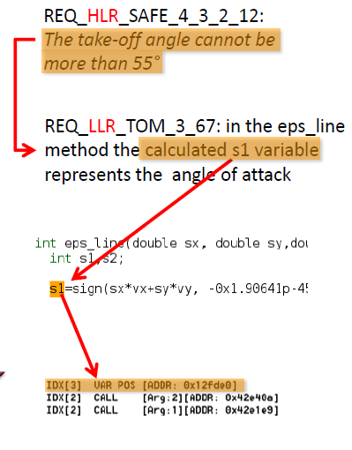
Traceability
Through the complete product life-cycle (30+ years)
From requirements to byte code (Level A)
Essential for maintainability
Back-annotation of errors
Typical implementation:
Excel
Doors
PTC Integrity
Code generators usually gives extensive support
Hard in case of multiple development tools

Slide 15
Verification
Two purposes
Demonstrate intended function
Demonstrate (to the extent possible) the absence of unintended function
Consists of
Reviews
Analysis
Testing
The FAA or EASA representative needs to accept all part of the verification process. (e.g., test cases)
Certification has legal issues : the developer is responsible!

Slide 16
Verification
Reviews:
Qualitative assessment of the process or product
Typical implementation: checklist
Applied on all SW Development process step (HLR, LLR, SW Arch., SW Coding, Test cases, etc.)
Analysis:
Provide repeatable evidence of correctness
Typical implementation: timing, stack analysis, data flow and call-tree

Slide 17
Verification – Testing
Testing:

Slide 18
Verification – Testing
Structural Coverage
Determine what software structure were not exercised
Levels:
Statement Coverage
Decision Coverage
Modified Decision / Condition Coverage (MC/DC)
Each decision tries every possible outcome
Each condition in a decision takes on every possible outcome
Each entry and exit point is invoked
Each condition in a decision is shown to independently affect the outcome of the decision
Gaps
Complier induced code (e.g., array bound checks)
Deactivated code
Dead code
Performed on source code,
except Level A
Correspondence must be shown
Complier optimization can introduce new code
In addition, coverage of data and control coupling is required

Slide 19
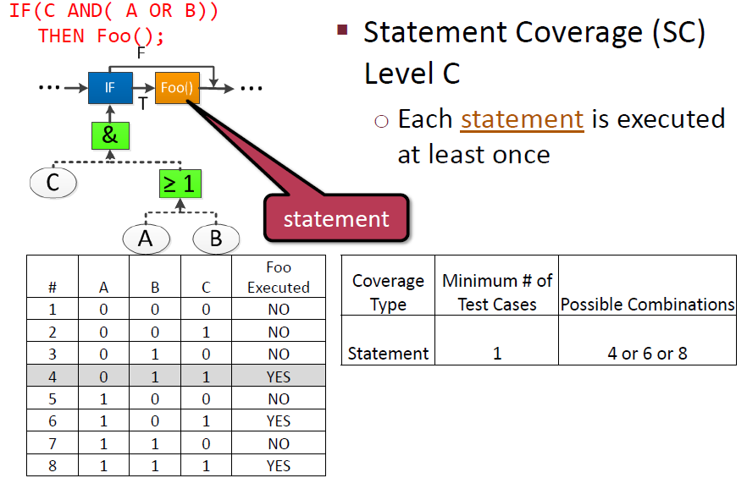
Verification – Testing examples (1/3)

Slide 20
Verification – Testing examples (1/3)

Slide 21
Verification – Testing examples (1/3)

Slide 22
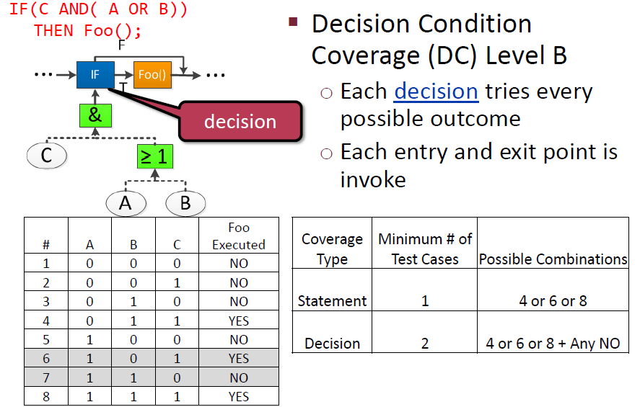
Verification – Testing examples (2/3)

Slide 23
Verification – Testing examples (2/3)

Slide 24
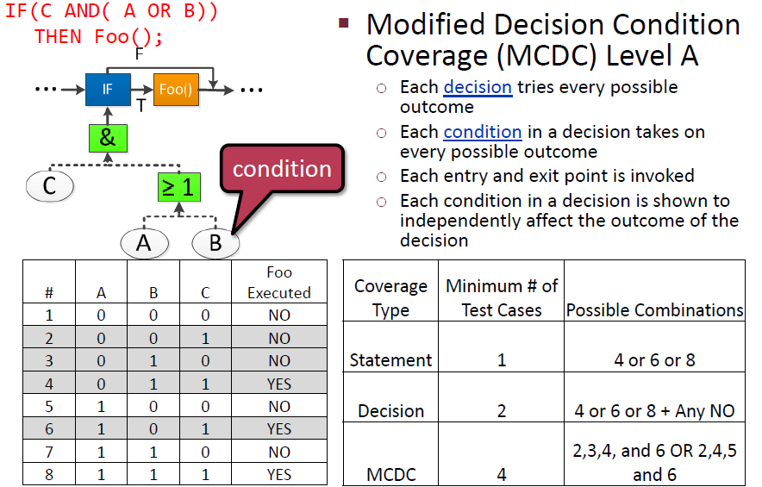
Verification – Testing examples (3/3)

Slide 25
Verification – Testing examples (3/3)

Slide 26
Annexes

Slide 27
DO-330 - Software Tool Qualification Considerations
Tools can introduce errors into the final system.
Especialy, SW development tools.
They are verified on the same level as the developed application.
The DO-330 « Software Tool Qualification Considerations » specifies 3 qualified tools categories and 5 TQL.
Corresponding more or less to DAL.
E.g., Scade Suite, Matlab Stateflow, Wind River Diab compiler

Slide 28
DO-331 - Model-Based Development and Verification Supplement to DO-178
Use of models for source code synthesis and verification
Early model based validation
Matlab Simulink (already used), AADL

Slide 29
DO-332 - Object-Oriented Technology and Related Techniques Supplement
Oversees the OOP related techniques, including:
parametric polymorphism
Overloading
type conversion
exception management
dynamic memory management
Virtualization
Liskov Substitution Principle

Slide 30
DO-333 - Formal Methods Supplement
Already used in many projects
Mature technologies available
Defines how certification credits can be earned by its use
Can be part of the Development process
Typical tools:
Model checker
Static code analyzers
Theorem provers (only in limited scenarios)

